Slide 1
Shoreline Community College Board of Trustees Study Session: June 25, 2014
Shoreline Community College
2014-15 Operating Budget

Slide 2
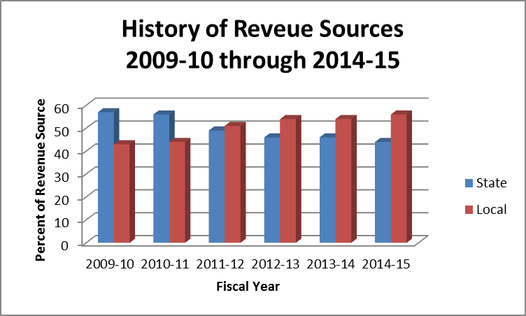

Slide 3
Strategic Planning Process
2014-15 Process
“Closing the Loop” 2013-14

Slide 4
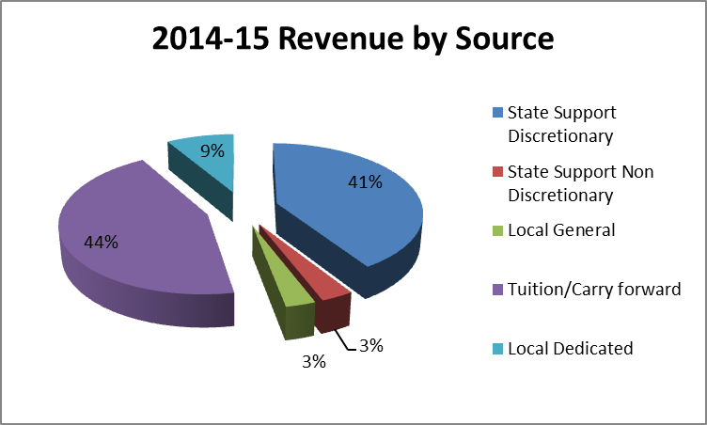

Slide 5
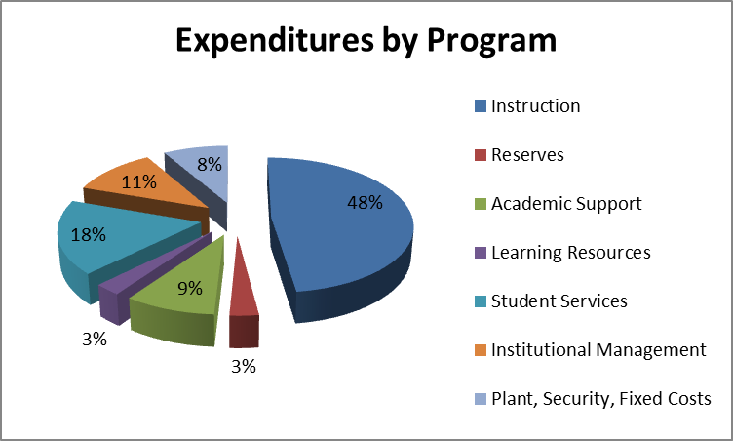

Slide 6
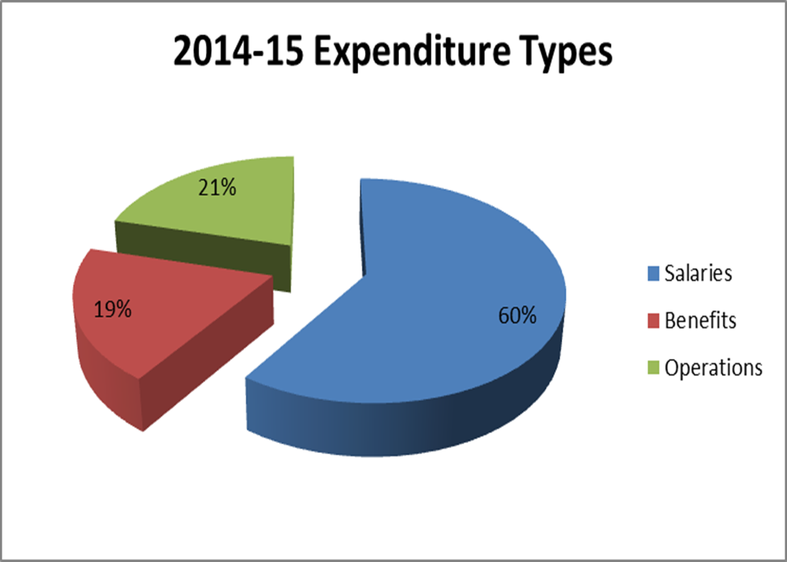

Slide 7
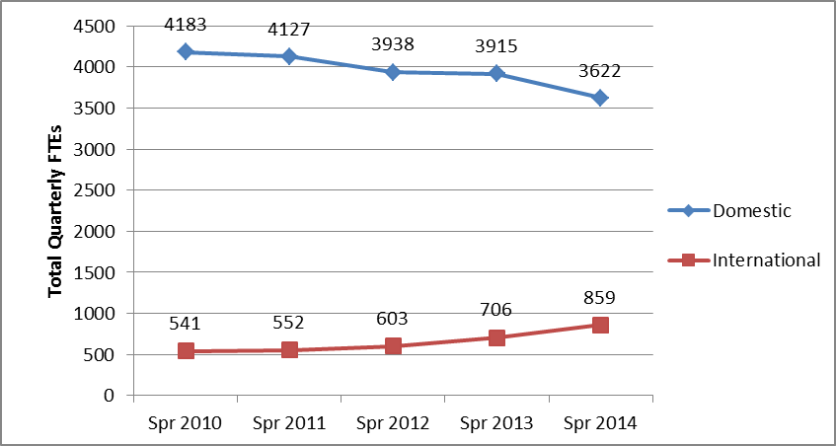
Enrollment: 2010 - 2014

Slide 8
2014-15 SAP Funding Allocations
Budget allocates ~$1.5 Million to approved SAPs, funded from a variety of sources:
$ | Source
$675,000 | Added to Operating Budget
$570,000 | Funded through various one-time sources
$140,000 | From existing operating budget, allocated to new strategic priorities
$130,000 | From Innovation and Opportunities Fund

Slide 9
Major Priorities Funded in 2014-15 Budget
Other: Marketing, Athletics, Financial Services, Workforce, Facilities,
International Education

Slide 10
Questions?

